Slide 1
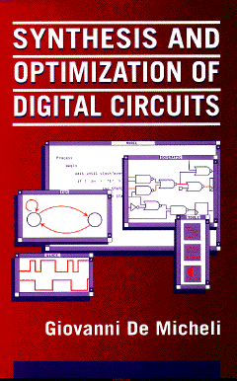


Design Technologies for Integrated Systems
Giovanni De Micheli
Integrated Systems Laboratory
This presentation can be used for non-commercial purposes as long as this note and the copyright footers are not removed
© Giovanni De Micheli – All rights reserved

Slide 2
Course objectives
A state-of-the art “chip” (integrated circuit) consists of up to trillions of transistors
These are designed using Electronic Design Automation (EDA) tools
In this course you will:
  Understand the inner workings of (some) EDA tools
    Models and algorithms
  How to use them effectively to design digital hardware

Slide 3
Module 1
Objective
  Electronic systems and their requirements
  Integrated circuits
  Design styles

Slide 4

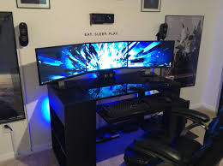


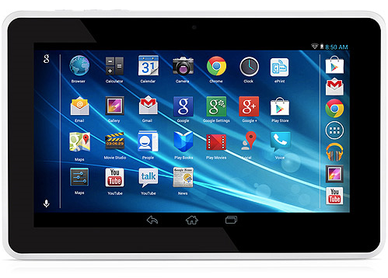
Computing today

Slide 5


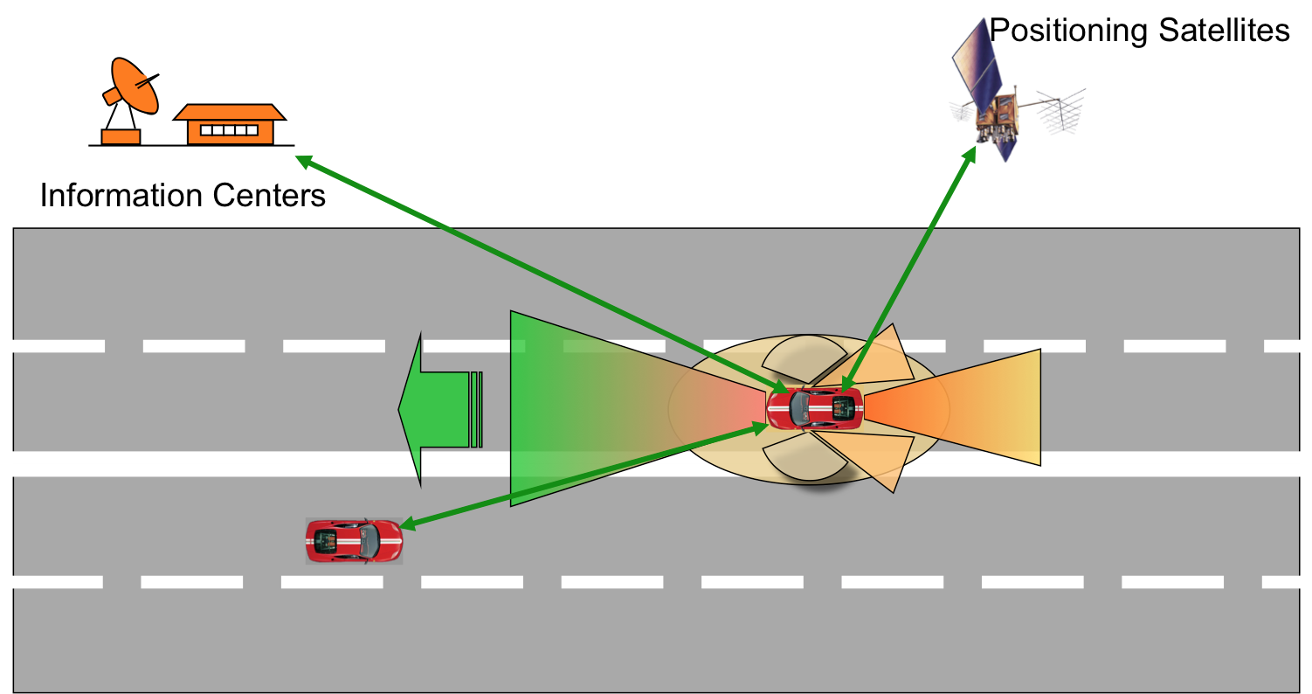
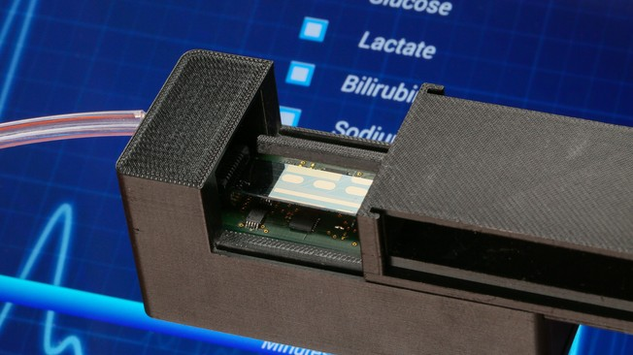
Computing today

Slide 6



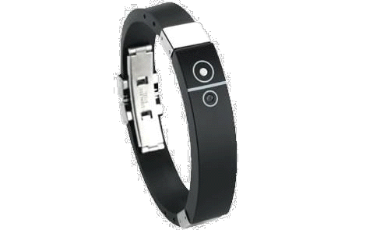











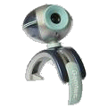







The Internet of Things
Infrastructural
Core
Sensory swarm
Mobile
access
[Courtesy: J. Rabaey]

Slide 7
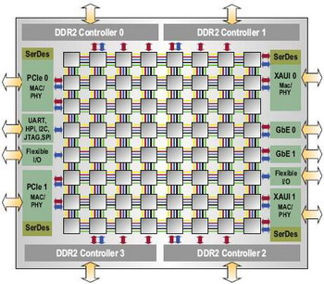
Requirements for electronic chip design
Mobility
Life critical
Complex Sw
Ultra low power
High reliability
High performance
Low voltage
Redundancy
Parallelism
From processors to multi-processors
  Clock speed limitaions
  Performance gain from parallelism
[Tilera]

Slide 8
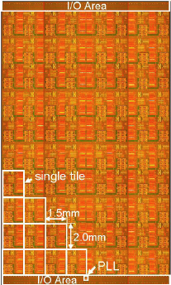



New communication structures
Design requirements:
  Predictable design
  Fast design closure
Network on Chip communication
  Modular and flexible interconnect
  Reliable on-chip communication
  Structured design with synthesis and optimization support
[Vangal, Intel07]
NoC
Models
NoC
Blocks
Packets
Routes
Topology
Synthesis
IP Cores
Back
End
Flow
FPGA
Comm
Graph
Topology
Generation
NoC
PE
ASIC
Network
Interface
Constraints
Goals
Floorplan
Notes:
8

Slide 9
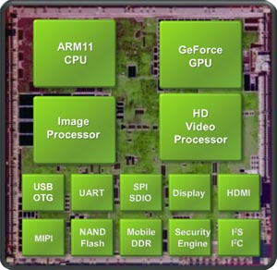
Systems on Chip
Large-scale
  Billion transistor chips
  Multi-cores, multi-threaded SW
Power-consumption limited
  Dark silicon
Very expensive to design
  Non recurring engineering (NRE) costs
  Migration toward software
NVIDIA TEGRA Processor

Slide 10
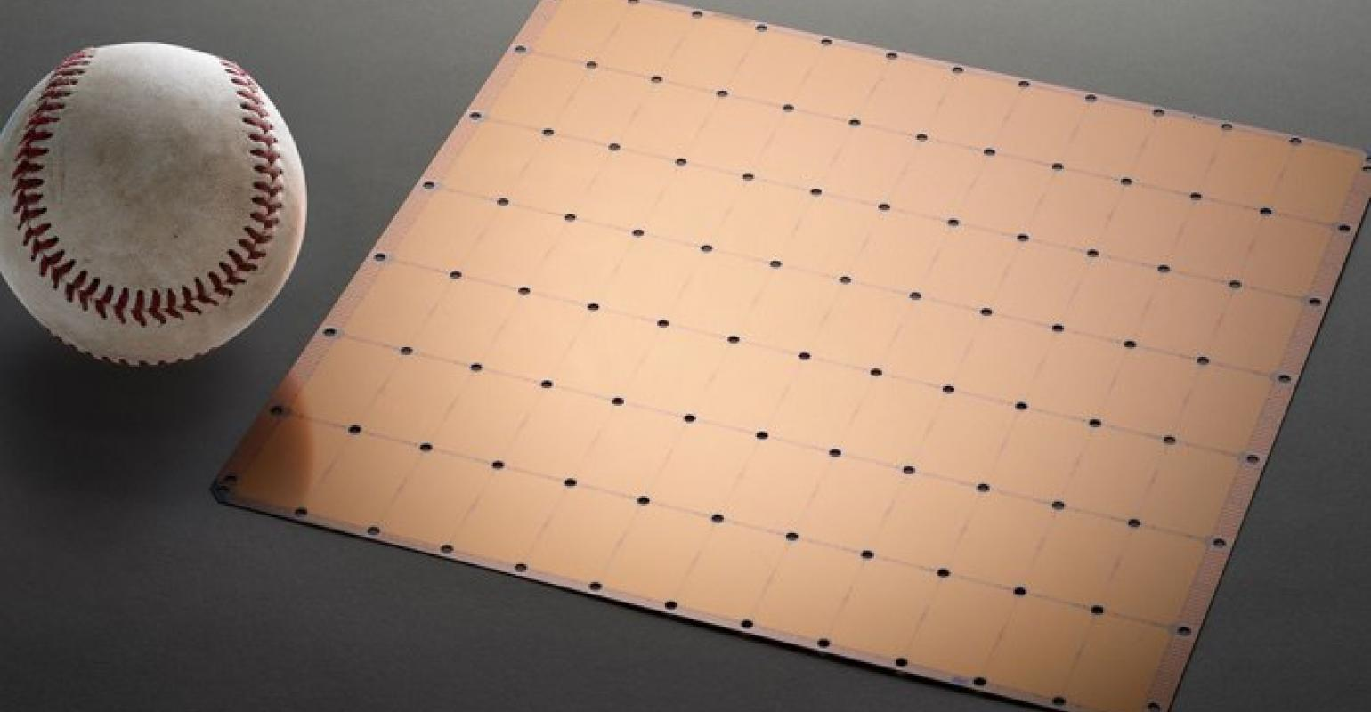
Wafer scale integration (Cerebras)
Notes:
2 Trillion transistrors
850’000 cores

Slide 11
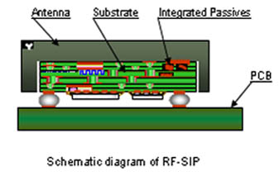
Systems in Package
There is a diminishing return in integrating everything on Silicon
  Heterogeneous technologies
  Multiple voltages
  Thermal issues
Packaging technology
Chiplets

Slide 12
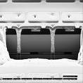
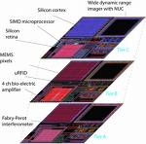
New packaging technology
From planar to 3D integration
  Chips have limited wiring resources
  Electrical and manufacturing constraints limit heterogeneous planar integration
Through silicon vias allow designer to stack:
  Computing arrays
  Memory arrays
  Analog and RF circuitry
[Fraunhofer]

Slide 13
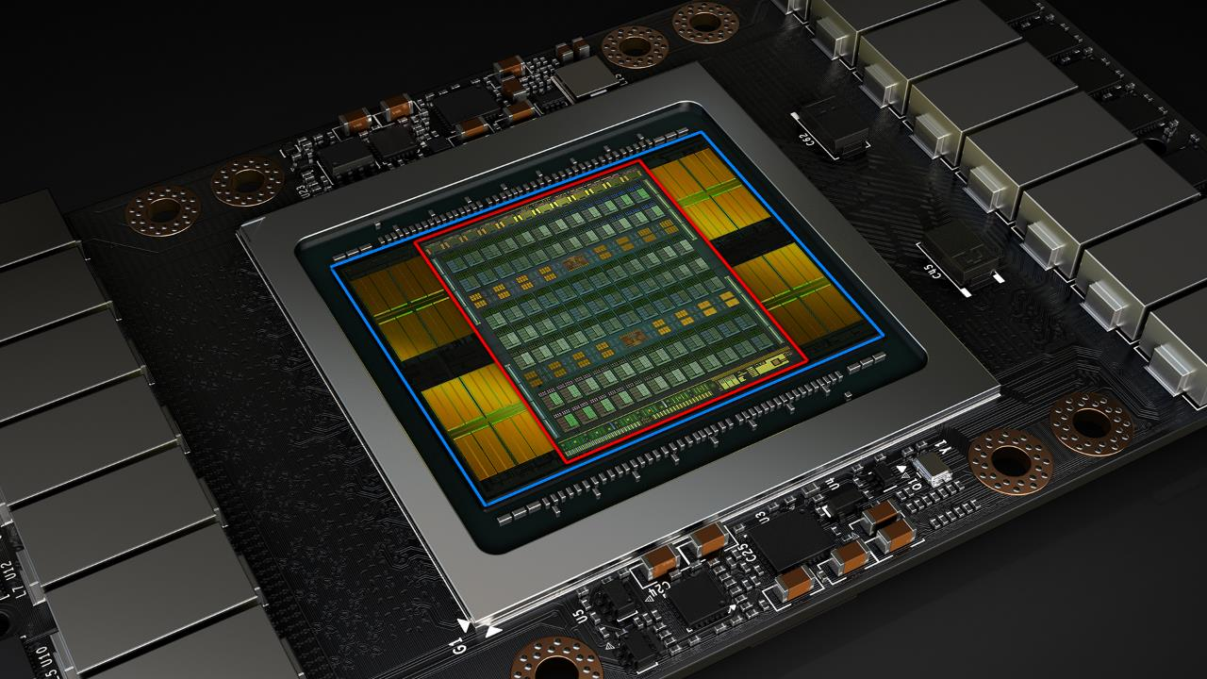
NVidia 2.5D-IC High BW Memory Application
GPU = 815 mm²
Silicon Interposer(s) ≅ 1,400 mm²
GPU Die (21B Transistors @ 12 Nanometers TSMC, 300W) + 4 HBM2 Stacks (4 × 4GB) Onto
Several Silicon Interposer Die Stitched Together, price at launch $10,000
“Volta” 5.5D-IC (3D + 2.5D) Integration; Source: J.-H. Huang, et al., NVIDIA, GPU Technology Conference 2017
Notes:
HBM = High Bandwidth memory, stacked die up to 8 DRAM dies, interconnected with TSV and microbumps

Slide 14
The emerging nano-technologies
Enhanced silicon CMOS is likely to remain the main manufacturing process in the medium term
  The 3nm technology node is here (Since 2023)
What are the candidate techs
for the 3nm node and beyond?
  Silicon Nanowires/sheets (SiNW))
  Carbon Nanotubes (CNT)
  2D devices (flatronics)
What is in common from a design standpoint?

Slide 15
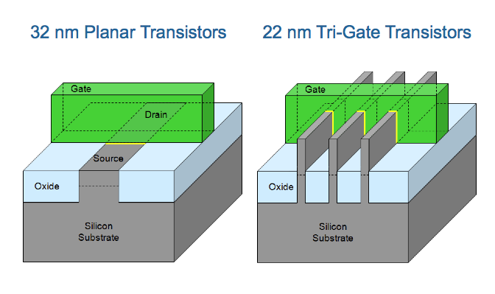
22 nm Tri-Gate Transistors
[Courtesy: M. Bohr]

Slide 16
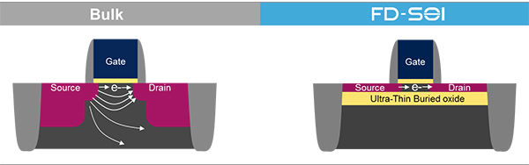
Fully Depleted SoI Transistors
[Courtesy: STMicroelectronics]
Transistor is built on top of buried oxide (BOX)
Thin, undoped channel (fully depleted)
Fine power-consumption control through body bias
Notes:
Fully Depleted Silicon On Insulator, or FD-SOI, is a planar process technology that relies on two primary innovations. First, an ultra-thin layer of insulator, called the buried oxide, is positioned on top of the base silicon.
Then, a very thin silicon film implements the transistor channel. Thanks to its thinness, there is no need to dope the channel, thus making the transistor Fully Depleted.
The combination of these two innovations is called “ultra-thin body and buried oxide Fully Depleted SOI” or UTBB-FD-SOI.
By construction, FD-SOI enables much better transistor electrostatic characteristics versus conventional bulk technology. The buried oxide layer lowers the parasitic capacitance between the source and the drain. It also efficiently confines the electrons flowing from the source to the drain, dramatically reducing performance-degrading leakage currents.
FD-SOI allows efficient transistor control
FD-SOI technology enables control of the behavior of transistors not only through the gate, but also by polarizing the substrate underneath the device, similarly to the body bias available in Bulk technology
In bulk technology, body biasing is very limited, due to parasitic current leakage and inefficiency at reduced transistor geometry.
Thanks to the transistor construction in FD-SOI and its ultra-thin insulator layer, biasing is much more efficient. Also, the presence of the buried oxide allows the application of higher biasing voltages, resulting in breakthrough dynamic control of the transistor
The FBB advantage
When polarization of the substrate is positive-- “Forward Body Biasing” or FBB-- the transistor can be switched faster.
This provides an extremely powerful technique to optimize performance and power consumption. Easy to implement, FBB can be modulated dynamically during the transistor operation, bringing a great flexibility for designers and letting them design their circuits to be faster when required and more energy efficient when performance isn’t as critical

Slide 17
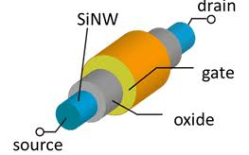
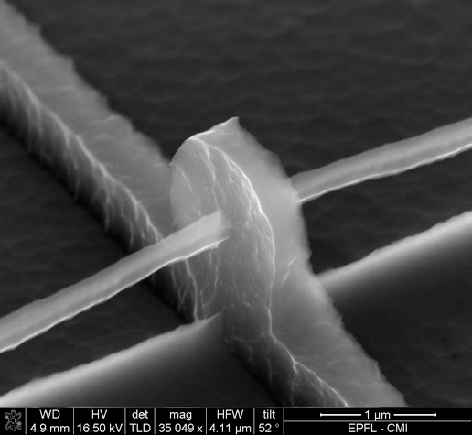
Silicon Nanowire Transistor
Fully compatible with CMOS process
Gate all around
High I_{on} / I_{off} ratio

Slide 18
FINFETs, NanoWires and NanoSheets
[INTEL, 2017]
Notes:
The 5 nano node is in progress
TSMC has sold to apple all its capacity for 2021 (Finfet)
The 3 nano node in progress (Samsung nanowire 22)
And then?
IM has announced the 2nm node in May 21

Slide 19
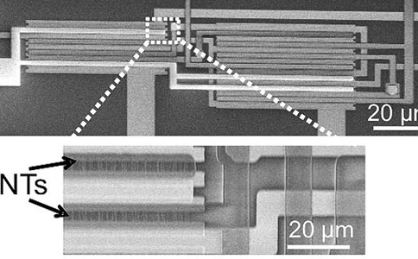
Carbon Nanotube Transistors
CNTs benefit from higher mobility and thus higher currents
CNTs grown separately but can be ported to Si wafers
Handling CNT imperfections is major design and fabrication issue

Slide 20
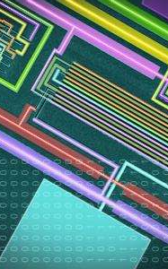
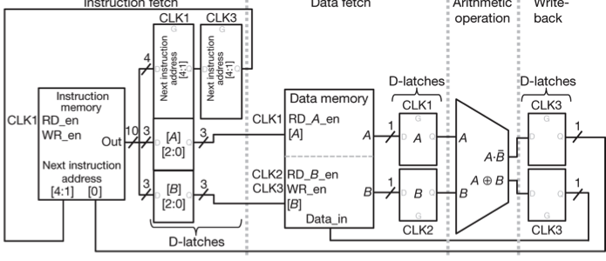
CNT nanocomputer
First CNT computing engine
Runs 20 MIPS instructions
Multitasking
[Shulaker, Wong, Mitra et al, NatureNano 13]

Slide 21
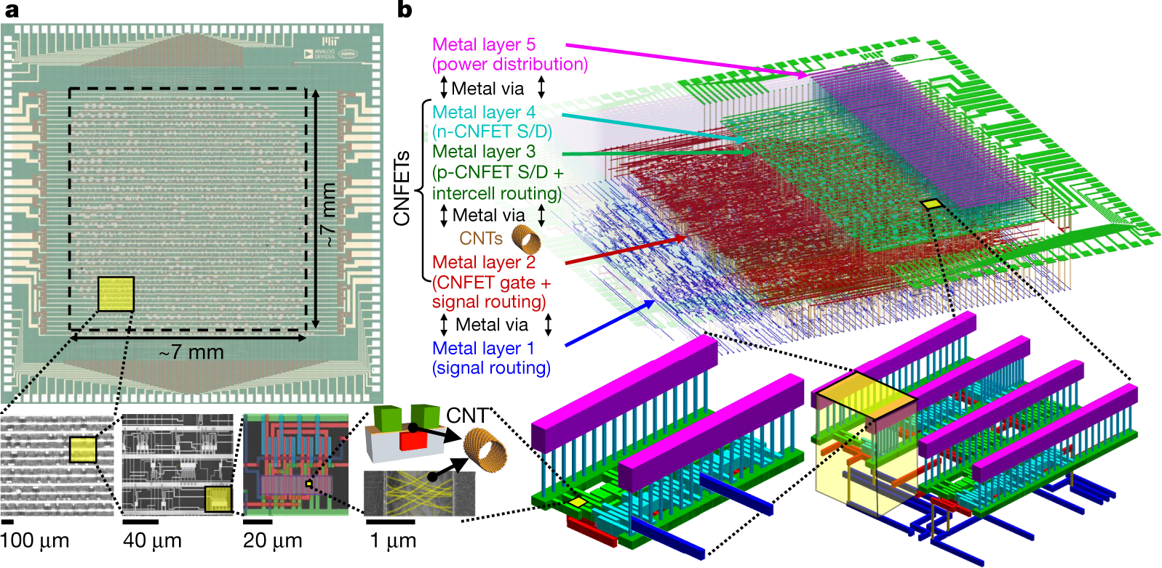
16B RISC-V 14’000 CNFET transistor chip
[Shulaker et al., Nature 19]
Notes:
Analog devices

Slide 22
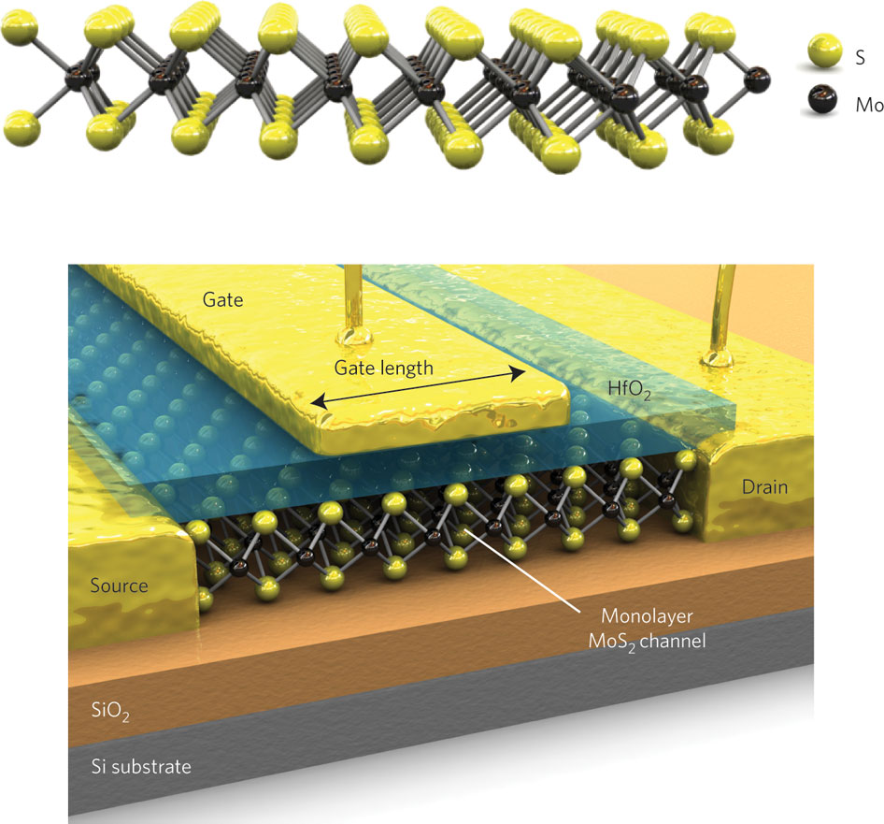
2D electronic technologies
[Kis, Nature Nano 2011]
Graphene, MoS₂ and other materials
Single or few atomic layers
High I_{on} / I_{off} ratio for MoS₂ (10⁸) but n-type mainly

Slide 23
MoS₂ nanocomputer
First MoS₂ computing engine
Runs 4instructions
115 N-xtors (enhancement load)
2 micron feature size
[Wacter et al. Nature Comm, 2017]

Slide 24
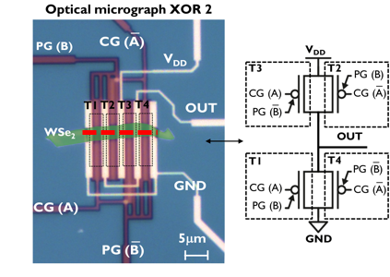
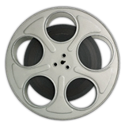
Controllable polarity transistors in 2D
2D Controllable-polarity EXOX in WSe₂
[Resta, ACS Nano 2017]

Slide 25
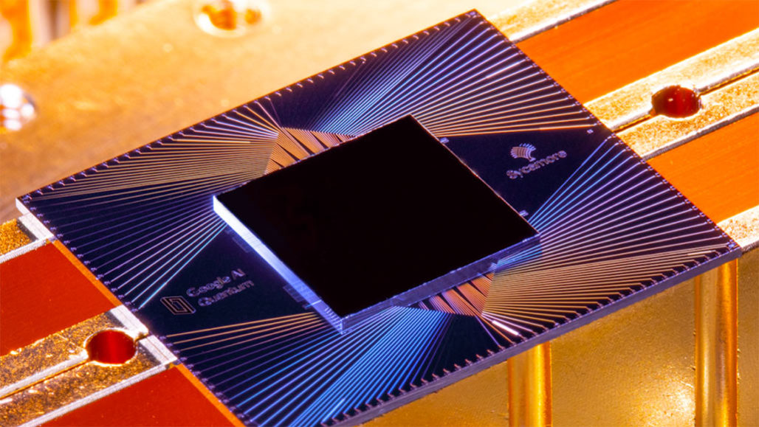
Quantum computing technologies
A wide array of realization technologies
Superconductors, silicon, optics
QC leverages superposition and entanglement
Support algorithms with lower complexity
Scaling and noise are still issues
Qubit count and coherence time are limited
Refrigeration to tenth of mK for noise reason
Interfacing to host is complex

Slide 26
Integrated Circuit Design Styles
Custom:
  All geometries are designed ad hoc
  Mainly abandoned, but useful for high-performance components
Semicustom:
  Optimality is traded-off for regularity
  Performance penalty is small, cost is lower

Slide 27
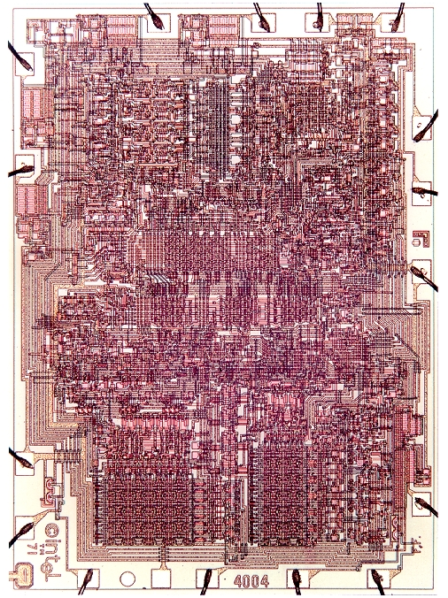
The Custom Approach
Intel 4004
Courtesy Intel
Notes:
This is an example of an early chip. Note the random wiring structure

Slide 28
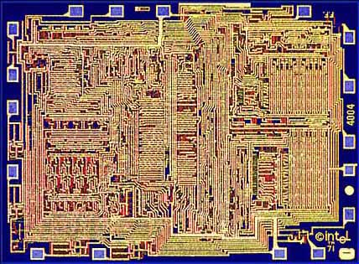
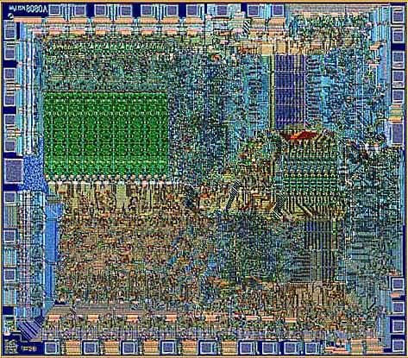
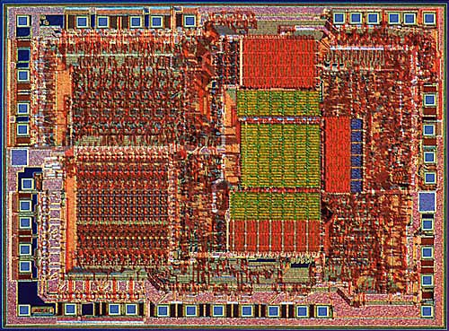
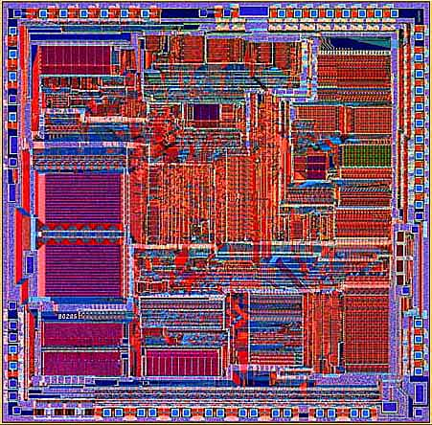
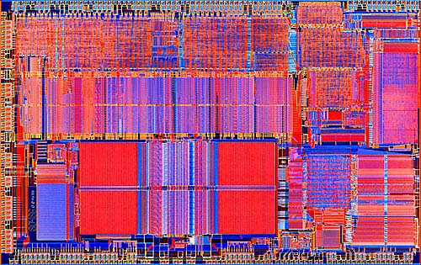
Transition to Automation and Regular Structures
Intel 4004 (‘71)
Intel 8080
Intel 8085
Intel 8286
Intel 8486
Courtesy Intel
Notes:
This slide shows an evolution of the Intel processors through the years. Note an increase in regularity and the presence of computational stacks.

Slide 29
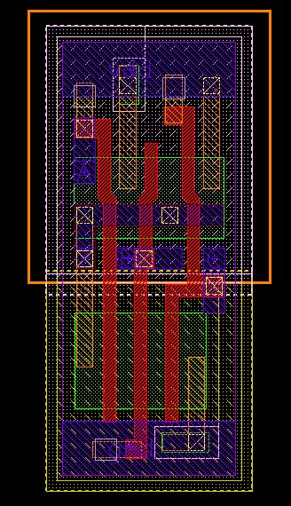
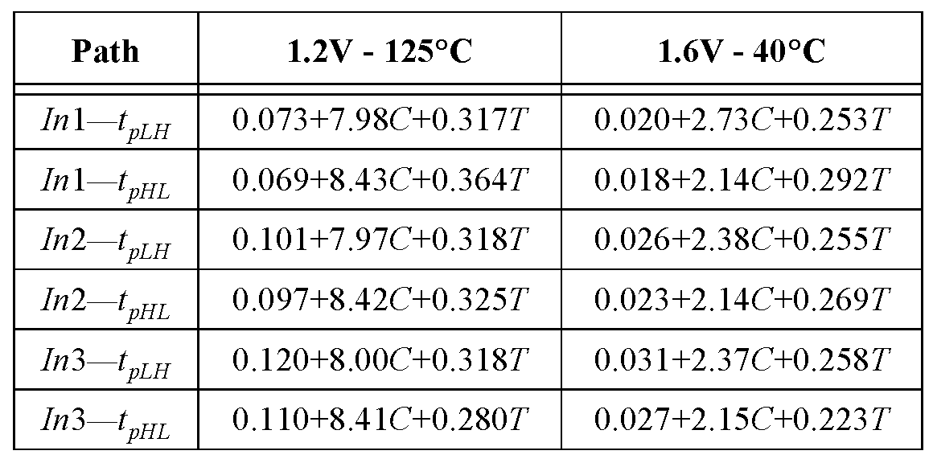
Standard Cell - Example
3-input NAND cell
(from ST Microelectronics):
C = Load capacitance
T = input rise/fall time
Notes:
This is an example of a standard cell from a library. It is a NAND. On the right, note how the cell can be characterized in terms of I/O delays that are a function of capacitive load and temperature.

Slide 30
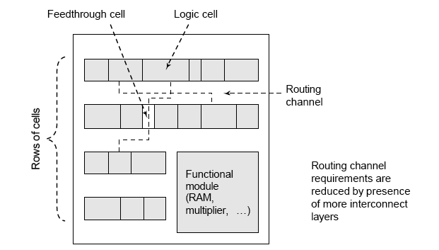
Cell-based Design (or standard cells)
Routing channel
requirements are
reduced by presence
of more interconnect
layers
Notes:
Cell-based design leverages the use of library cells, that can be designed once and stored.
Instead, the design process is simplified, because of the use of ready-made building blocks.
This simple layout style shows cell laid out in rows and separated by channels for routing.
It also shows that macro-cells can be added to a standard cell design flow.
Note that this style is compatible with the older 2-metal technologies.

Slide 31
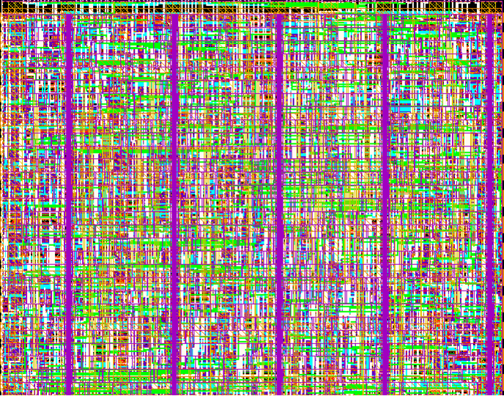
Standard Cell – The New Generation
Cell-structure
hidden under
interconnect layers
Notes:
In modern standard cell design, with 6-10 levels of metal, you can route over the cells and place cells adjacent to each other. The picture just shows the top wiring layers.

Slide 32
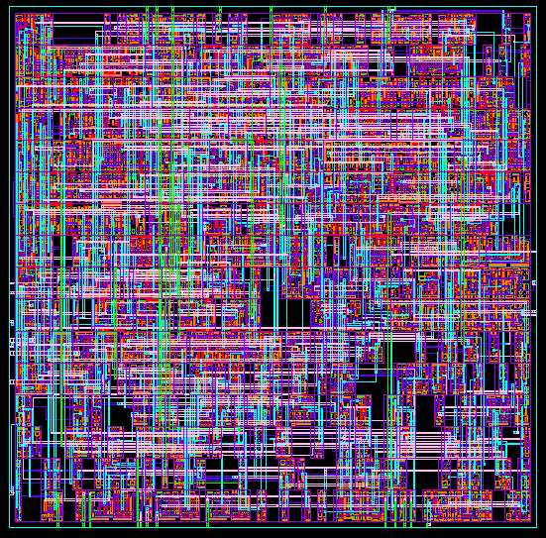
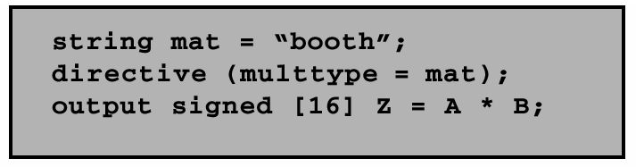
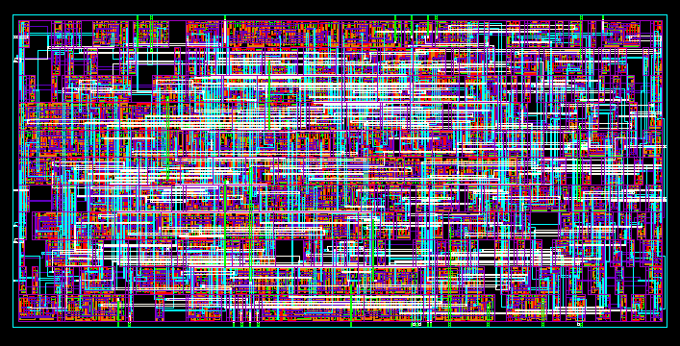
“Soft” MacroModules
Synopsys DesignCompiler
Notes:
Macro cells can be generated by layout generators: these can take the aspect ratio as a constraint. In the example above, you can see the cell realized as a square or rectangular macro.

Slide 33
Gate Array — Sea-of-gates
Uncommited
Cell
Committed
Cell
(4-input NOR)
Notes:
In gate arrays, batches of wafers, with arrays of sites, are manufactured. The chip fabrication process entails programming the sites by contacting them to wires, i.e. by manufacturing the routing layers. As a result, only the metal and contact layers are used to program the chip, hence the name mask programmable. Fewer manufacturing steps correlate to lower fabrication time and cost. In addition, the cost of the pre-diffused batches of wafers can be amortized over several chip designs.

Slide 34
Field-Programmable Gate Arrays
Fuse-based
Standard-cell like
floorplan
Notes:
Pre-wired gate arrays or Field Programmable Gate Arrays (FPGAs) can be programmed in the 'field', i.e. outside the semiconductor foundry. They consist of arrays of programmable modules, each having the capability of implementing a generic logic function. Wires, already present in form of segments, can be connected by programming anti-fuses or transistors. (A fuse is a a short circuit device that becomes an open circuit when traversed by an appropriate current pulse.
Conversely, an anti-fuse is an open circuit device that becomes a short circuit when traversed by an appropriate current pulse.)
Generic functions can be specialized by connecting module inputs to voltage rails or together.
Anti-fuse based FPGAs are non-volatile but can be programmed only once.

Slide 35
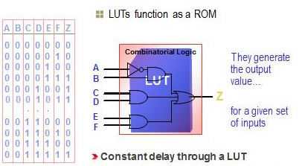
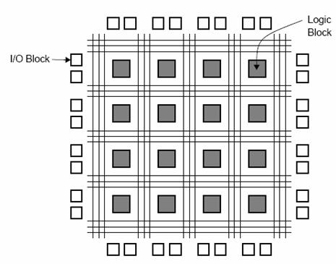
Field Programmable Gate Arrays
Xilinx LUT Architecture
Courtesy Xilinx
Notes:
Soft programmable FPGAs consist of a network of Configurable Logic Blocks (CLBs) that are like small memory arrays that can be configured to implement combinational functions (with latching).
Wiring is achieved by turning on transistors joining wires at cross points.
The full circuit configuration consists of the map of the interconnection transistors to be turned on and of the CLB configurations. When an FPGA is used multiple times on the same function, the configuration is stored on an outside ROM.

Slide 36
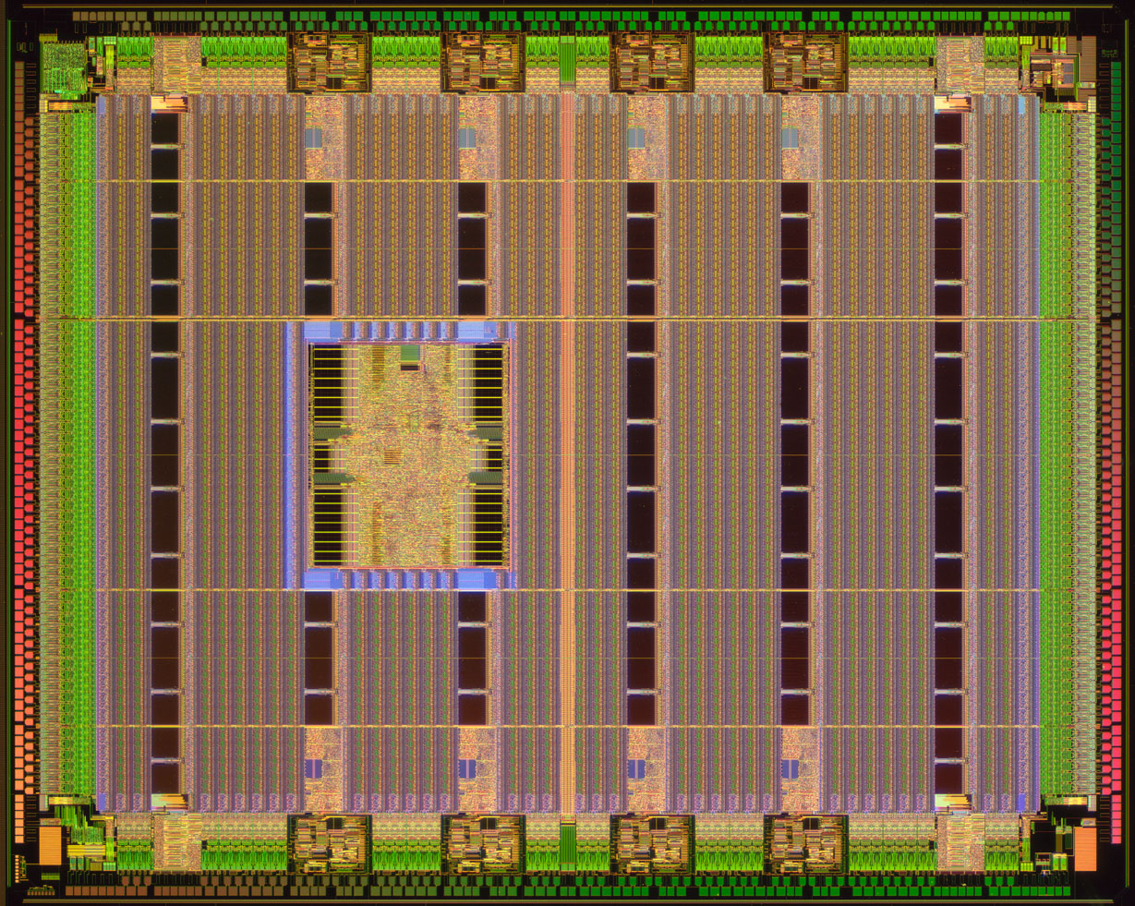
Heterogeneous Programmable Platforms
FPGA Fabric
Embedded memories
Embedded PowerPc
Hardwired multipliers
Xilinx Virtex-II Pro
High-speed I/O
Courtesy Xilinx
Notes:
This picture shows an advanced FPGA by Xilinx. Besides CLBs, the array contains complex macros, such as multipliers, memories and processors.

Slide 37
Integrated Circuit Design Styles
Digital Circuit Implementation Approaches
Custom
Semicustom
Cell-based
Array-based
Standard Cells
Ma
cro Cells
Pre-diffused
Pre-wired
Compiled Cells
(Gate Arrays)
(FPGA's)
Notes:
Different design styles, often called methodologies, have been used for microelectronic circuits. They are usually classified as custom and semicustom design styles.
In the former case, the functional and physical design are hand-crafted, requiring an extensive effort of a design team to optimize each detailed feature of the circuit. In this case,the design effort and cost are high, often compensated by the achievement of high quality circuits. It is obvious that the cost has either to be amortized over a large volume production (as in the case of processor design) or born in full (as in the case of special applications). Custom design was popular in the early years of microelectronics. Today, the design complexity has confined custom design techniques to specific portions of a limited number of projects, such as execution and floating point units of some processors.
Semicustom design is based on the concept of restricting the circuit primitives to a limited number, and therefore reducing the possibility of fine tuning all parts of a circuit design. The restriction allows the designer to leverage well-designed and well-characterized primitives and to focus on their interconnection.
The reduction of the possible number of implementation choices makes it easier to develop CAD tools for design and optimization, as well as reducing the design time. The loss in quality is often very small, because fine-tuning a custom design may be extremely difficult when this is large and automated optimization techniques for semi-custom styles can explore a much wider class
of implementation choices than a designer team can afford.

Slide 38
The Basic Trade-Offs
Cost [log]
Custom: Lowest cost/size at high volume, best performance
Semi-Custom: Slightly higher cost/size at volume, performance
SW: Highest flexibility
FPGA: High flexibility
chips/year [log]
Design Cost (aka NRE)
Notes:
At $100M design cost, only 10 cents NRE at a billion, all cost is variable
NRE – Non Recurrent Engineering – the cost of 1 chip
There are things that can be done only in HW, e.g. low power, speed

Slide 39
Moore’s law
Source: Gordon E. Moore,
Cramming More Components onto Integrated Circuits,
Electronics, pp. 114–117, April 19, 1965.

Slide 40
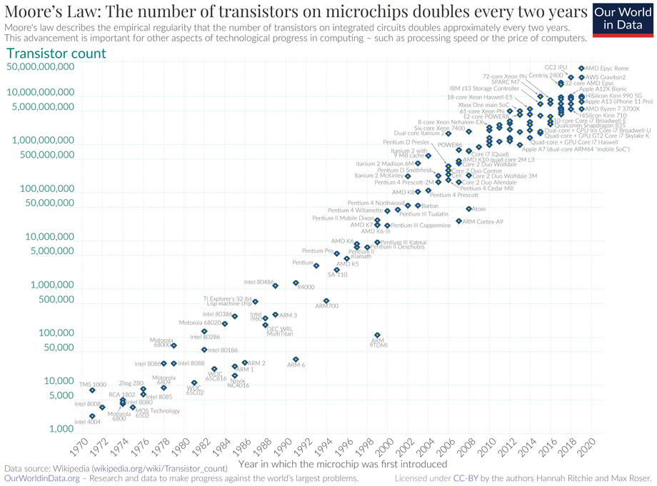
End of Moore’s Law?
Notes:
Mark Twain: The rumors of my death are greatly exagerated

Slide 41
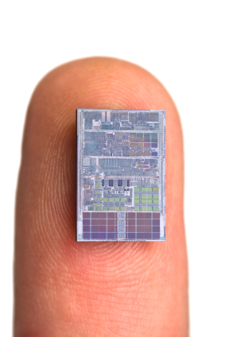
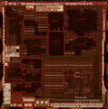
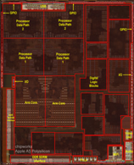
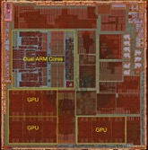
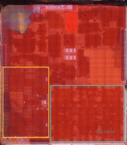
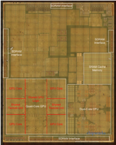

8 Generations of Apple Mobile System-on-Chips
Chip | A4 | A5 | A6 | A7 | A8 | A9 | A10 | A11
Year | 2010 | 2011 | 2012 | 2013 | 2014 | 2015 | 2016 | 2017
Device | iPhone 4 | iPhone 4s | iPhone 5 | iPhone 5s | iPhone 6 | iPhone 6s | iPhone 7 | iPhone 8 & X
Node | 45nm Samsung | 45nm Samsung | 32nm Samsung | 28nm Samsung | 20nm TSMC | 16nm/14nm TSMC/Samsung | 16nm TSMC | 10nm TSMC
Area [cm2] | 0.52 | 1.25 | 0.96 | 1.03 | 0.89 | 1.05/0.96 | 1.25 | 0.88
Die photos: chipworks/TechInsights
Data source: wikipedia

Slide 43


Slide 44
Design Capabilities Today
Processor | Transistors | Year | Designer | Process | Area [mm²]
Intel 4004 | 2300 | 1971 | Intel | 10 μm | 12
Intel 8008 | 3500 | 1972 | Intel | 10 μm | 14
22 core Xeon Broadwell E5 | 7.2B | 2016 | Intel | 14 nm | 456
32 core AMD Epyc | 19.2B | 2017 | AMD | 14 nm | 4 x 192
FPGA
Virtex-7 | 6.8B | 2011 | Xilinx | 28nm
Stratix 10 | 17B | 2017 | Intel / Altera | 14nm | 560
Virtex Ultrascale XCVU440 | 20B | 2014 | Xilinx | 20nm
GPU
GP 100 Pascal | 15.3B | 2016 | Nvidia | 16nm | 610
GV 100 Volta | 21.1B | 2017 | Nvidia | 12nm | 815
Billions of transistors
Trillions of poligons
Source: Wikipedia
Notes:
. The A16 has 16 billion transistors and is built on TSMC's N4 fabrication process, being touted by Apple as the first 4 nm processor in a smartphone.[

Slide 45
Module 2
Objective
  Electronic design automation
  Synthesis and optimization
  Multi-criteria optimization

Slide 46
Computer-aided design
Enabling design methodology
  Support large scale system design
  Design optimization, centering and trade-off
  Reduce design time and time to market
… the only purpose of science is to ease the hardship of human existence … [Galileo/Brecht]
Notes:
Computer-Aided Design, also called electronic design automation, is the technology that facilitates engineers in designing chips.

Slide 47
Microelectronic circuit design
Conceptualization and modeling
  Hardware description languages
Synthesis and optimization
  Model refinement
Validation
  Check for correctness
Notes:
We shall consider here the design stage in more detail, and we partition it into three major tasks: conceptualization and modeling, synthesis and optimization, and validation.
The first task consists of casting an idea into a model, that captures the function that the circuit will perform.
Synthesis consists of refining the model, from an abstract one to a detailed one, that has all features required for fabrication. An objective
of design is to maximize some figures of merit of the circuit, that relate to its quality.
Validation consists of verifying the consistency of the models used during design, as well as some properties of the original model.

Slide 48
Synthesis history
Few logic synthesis algorithms and tools existed in the 70’s
Link to place and route for automatic design
  Innovative methods at IBM, Bell Labs, Berkeley, Stanford
First prototype synthesis tools in the early 80s
  YLE [Brayton], MIS [Berkeley], Espresso
First logic synthesis companies in the late 80’s
  Synopsys and others
Notes:
Synthesis developed in the eighties along with the growth of semi-custom foundries and satisfied the need of quick time to market.

Slide 49

Modeling abstractions
Architectural level
  Operations implemented by resources
Logic level
  Logic functions implemented by gates
Geometrical level
  Transistors and wires
Notes:
A model of a circuit is an abstraction, i.e. a representation that shows relevant features without associated details.
Synthesis is the generation of a circuit model, starting from less detailed one.
Models can be classified in terms of levels of abstraction and views.
We consider here three main abstractions, namely: architectural, logic and physical.
The levels can be visualized as follows.
At the architectural level a circuit performs a set of operations, such as data computation or transfer.
At the logic level, a digital circuit evaluates a set of logic functions.
At the geometrical level, a circuit is a set of geometrical entities. % and it provides a set of signals.
Examples of representations for architectural models are HDL models or flow-diagrams, for logic models are state-transition diagrams or schematics, for geometric models are floor-plans or layouts.

Slide 50
Circuit synthesis
Architectural-level synthesis
  Determine macroscopic structure
    Interconnection of major building blocks
Logic-level synthesis
  Determine the microscopic structure
    Interconnection of logic gates
Physical design
  Geometrical-level synthesis
  Determine positions and connections
Notes:
Circuit synthesis can be classified roughly according the abstraction level.
Namely we have:
Architectural, or behavioral, or high-level synthesis
Logic Synthesis
Physical synthesis or Physical design

Slide 51
Synthesis levels
b-view
s-view
a-synthesis
a-level
l-synthesis
l-level
p-design
g-level
p-view
Notes:
A model can be seen under several views, namely: behavioral, structural and physical.
Behavioral views describe the function of the circuit regardless of its implementation.
Structural views describe a model as an interconnection of components.
Physical views relate to the physical objects (e.g. transistors) of a design.
Views are independent of the abstraction level.
On each abstraction level, synthesis can be seen as the change of view.

Slide 52
Synthesis and optimization
Synthesis with no optimization has no value
Optimization is the means to outperform manual design
Objectives
  Performance
    Frequency, latency, throughput
  Energy consumption
  Area (yield and packaging cost)
  Testability, dependability, …
Optimization has multiple objectives
  Trade off
Notes:
Circuit optimization is often performed in conjunction with synthesis.
Optimization is motivated not only by the desire of maximizing the circuit quality, but also by the fact that synthesis without optimization would yield non competitive
circuits at all, and therefore its value would be marginal.
Typical objectives are performance, power consumption and area.

Slide 53

Combinational circuit optimization
Notes:
This picture shows trade-off design points for a combinational circuit.

Slide 54
Optimization trade-off in sequential circuits
Area
Area
Area
Area Max
Cycle-time
Latency
Latency
Latency
Latency Max
Notes:
This picture shows the trade-off points for a sequential circuit, with trade-off among area, latency and cycle time.

Slide 55
Pareto points
Multi-criteria optimization
Multiple objectives
Pareto point:
  A point of the design space is a Pareto point if there is no other point with:
    At least one inferior objectives
    All other objectives inferior or equal
Notes:
Circuit optimization corresponds to searching for the best design, i.e. a circuit configuration that optimizes all objectives.
Since our optimization problem involves multiple criteria, special attention must be given to defining points of optimality.
For the sake of simplicity and clarity, and without loss of generality, we assume now that the optimization problem corresponds to a minimization one.
Note that maximizing the throughput corresponds to minimizing its complement.
A point of the design space is called a Pareto point if there is no other point (in the design space) with at least an inferior objective, all others being inferior or equal.
A Pareto point corresponds to a global optimum in a mono-dimensional design evaluation space.
It is a generalization of this concept in the more general context.
Note that there be many Pareto points, corresponding to the design implementations not dominated by others and hence worth consideration.

Slide 56
Example
Differential equation solver
diffeq {
  read ( x, y, u, dx, a ) ;
  repeat {
    xl = x + dx;
    ul = u – ( 3 . x . u . dx ) – ( 3 . y . dx ) ;
    yl = y + u . dx ;
    c = x < a ;
    x = xl; u = ul; y = yl ;
  until ( c );
write ( y )
}
Notes:
This example shows – in pseudo code – a model of a circuit that integrates a differential equation with step dx over an interval a.
The model reads the data, performs a loop, and outputs data.
The model is hard coded to do the integration of a specific differential equation, with the forward Euler model.

Slide 57
Example
*
ALU
STEERING & MEMORY
CONTROL UNIT
*
ALU
STEERING & MEMORY
CONTROL UNIT
*
ALU
Notes:
Here you see two possible implementation of the differential equation integrator.
In the top case, only one multiplier and ALU is used. In the bottom case, two multipliers and ALUs are used. With more computational resources, latency is smaller and area is larger

Slide 58
Example
Area
15
(2,2)
13
(2,1)
12
10
X
(1,2)
8
7
(1,1)
5
Latency
1
2
3
4
5
6
7
8
Notes:
Let us assume that the multiplier takes 5 units of area, the ALU 1 unit and the control-unit, steering logic and memory an additional unit.
Then, in the design evaluation space, the first implementation has area equal to seven and latency proportional to seven.
The second implementation has area equal to thirteen and latency proportional to 4. There are 3 Pareto points. The point (1,2) is dominated.

Slide 59
Summary
Computer-aided IC design methodology:
  Capture design by HDL models
  Synthesize more detailed abstractions
  Optimize circuit parameters
Evolving scientific discipline
Notes:
CAD is a complex area. We can distinguish CAD for circuits and CAD for systems.
The latter involves sw design and is not covered in this course.

